Slide 1

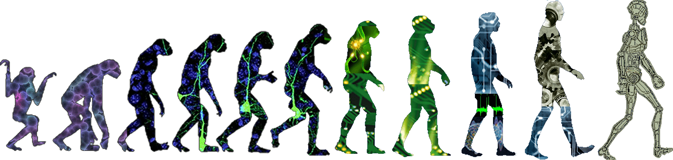
Autonomous Coupling of a UAV and UGV Technical Presentation and Interview for Design Criteria Engineer (Vehicle Engineering) Undergraduate Honors Thesis by Chris Breaux Supervised by Dr. Panagiotis Artemiadis

Slide 2
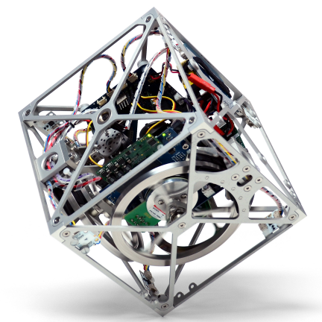
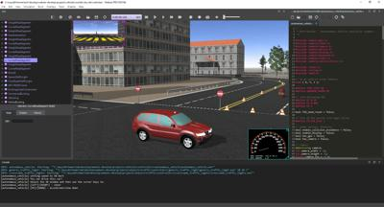
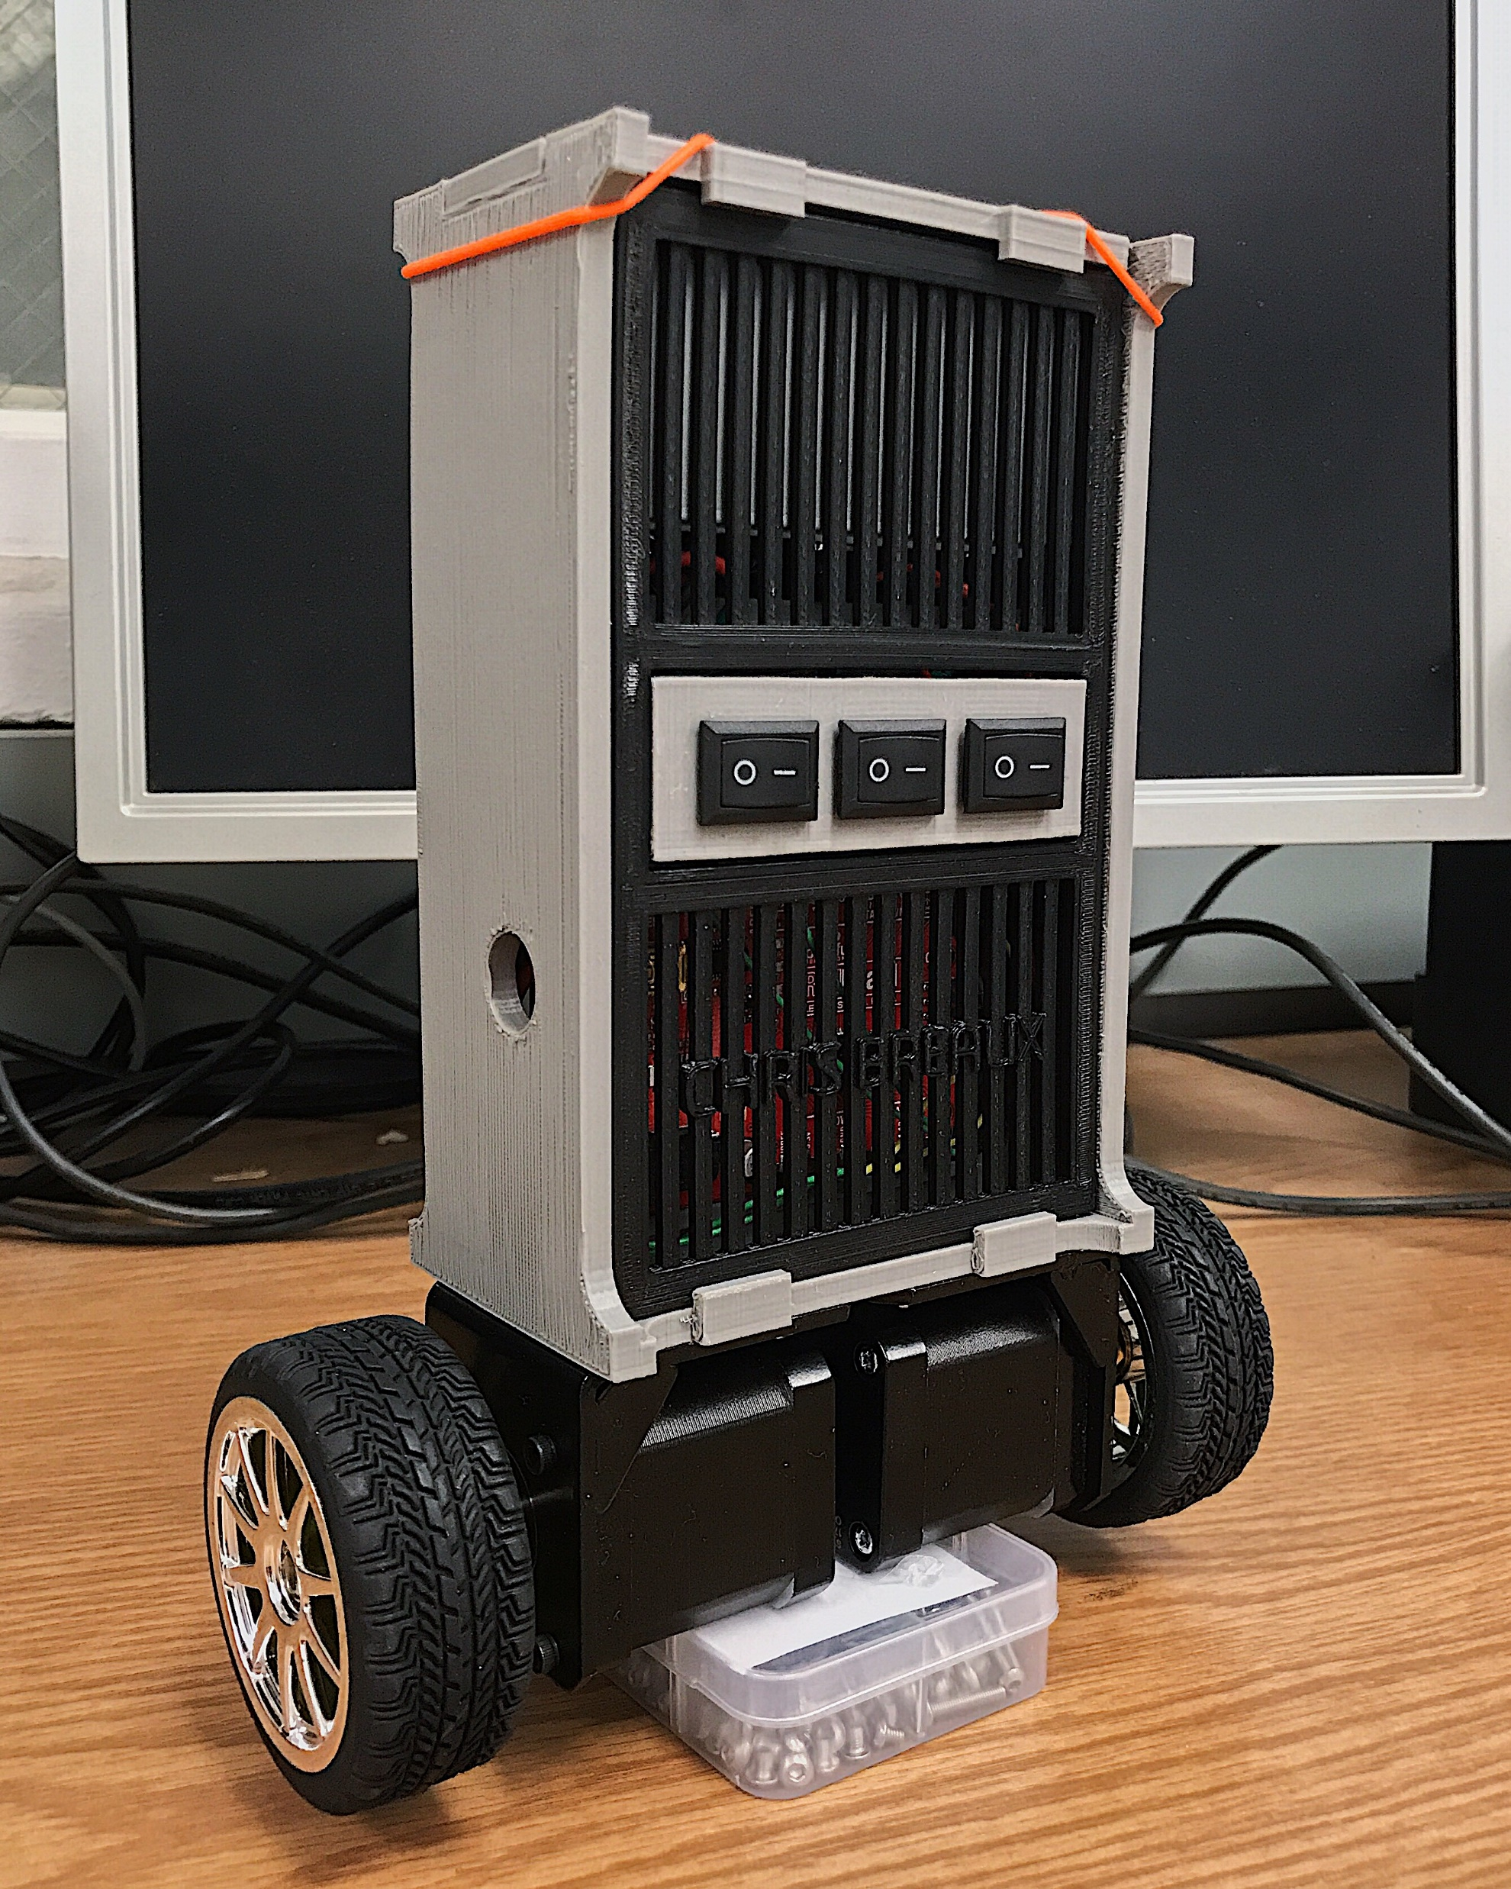
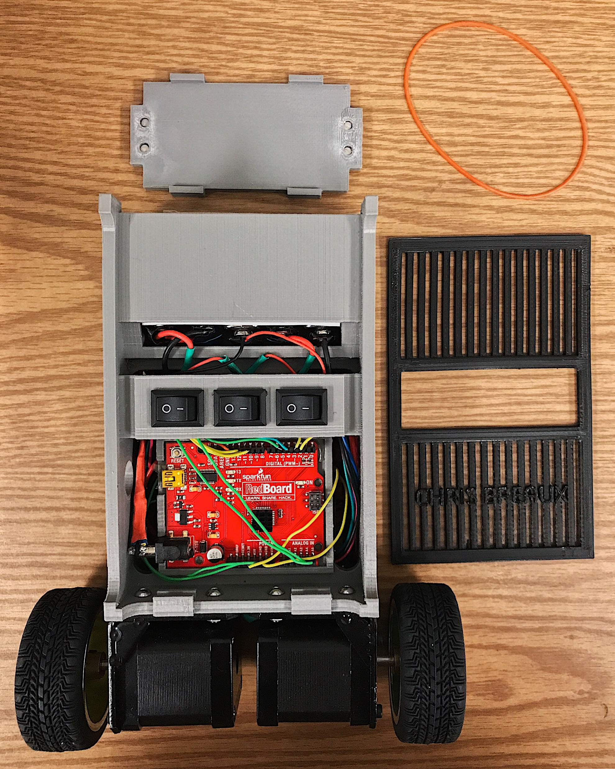
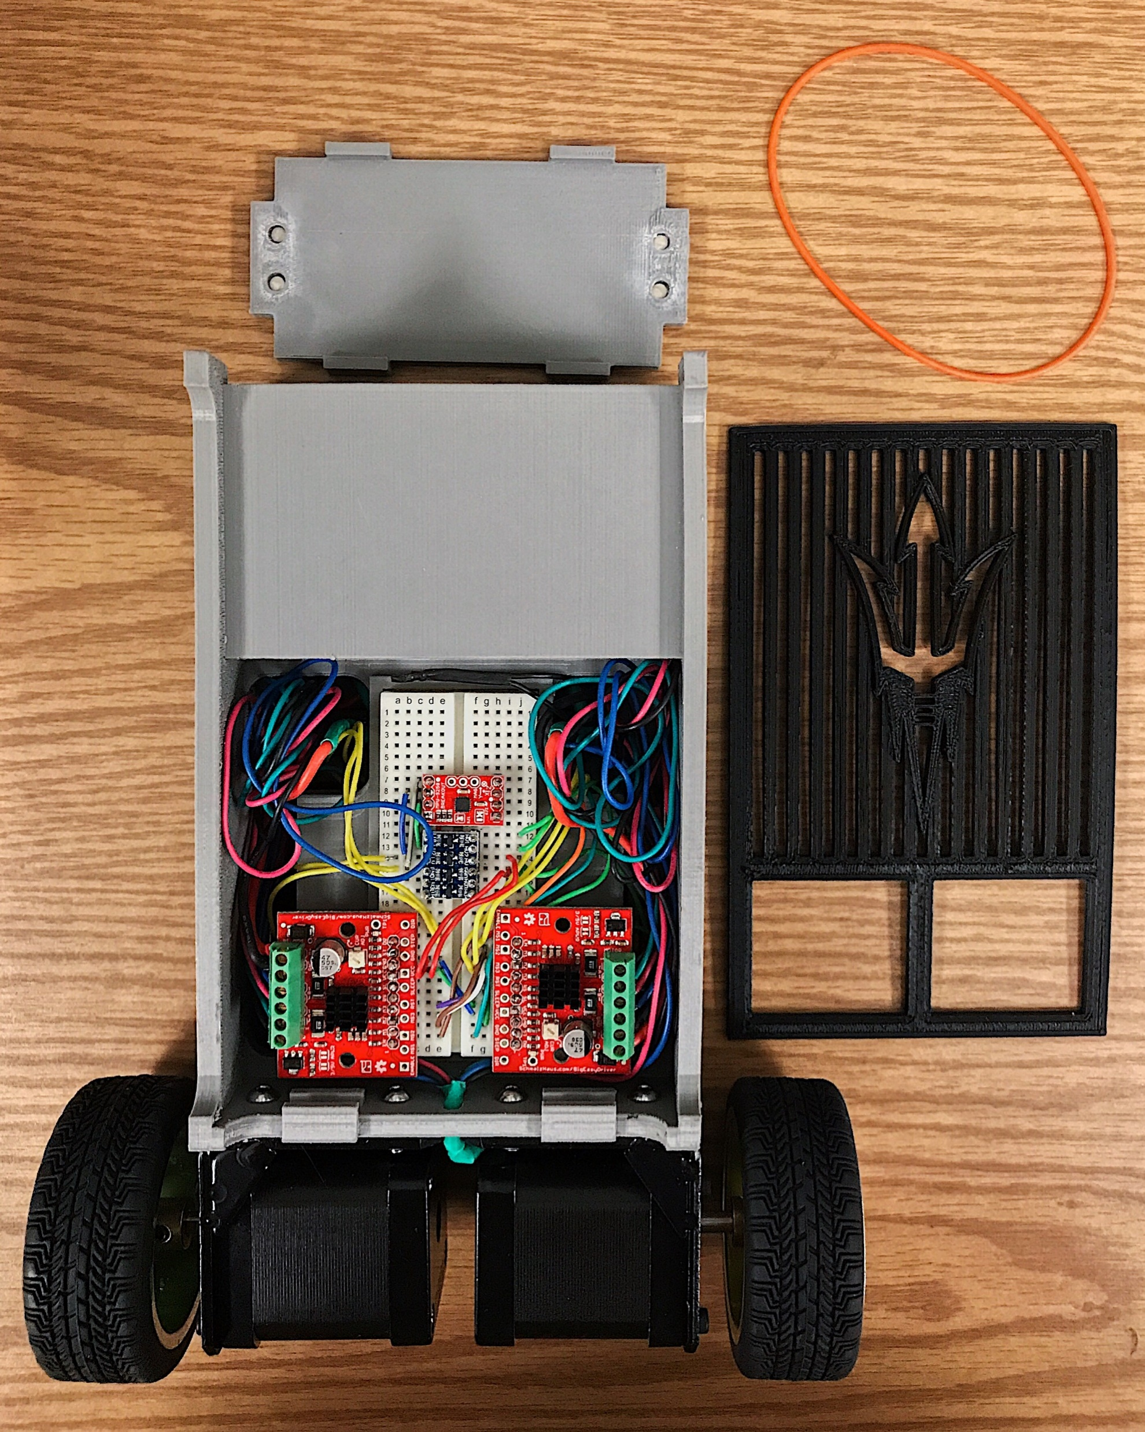
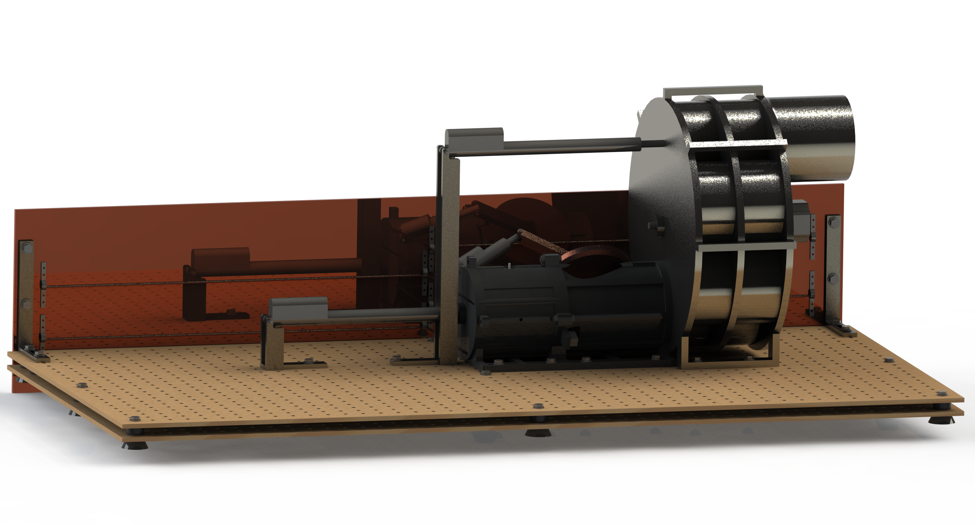
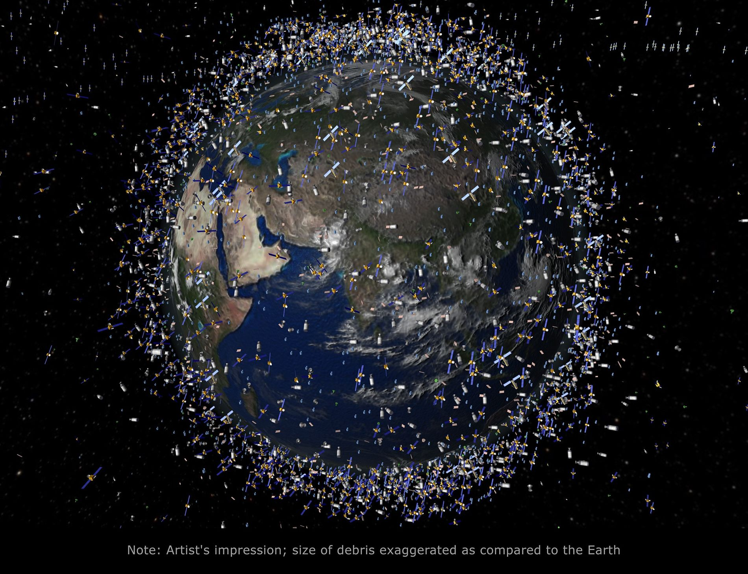
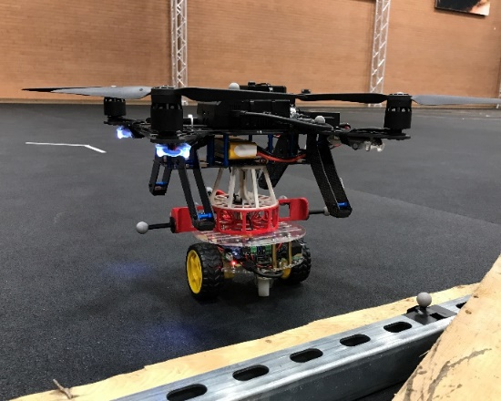
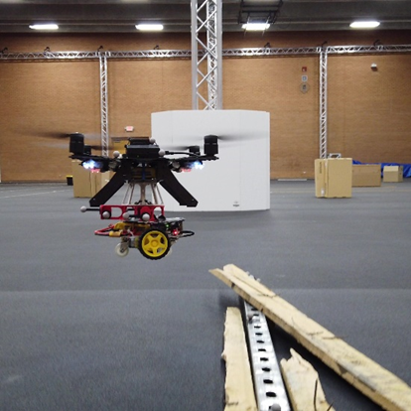
Background
Numerical Simulator for Lunar Tumbling Robot
Satellite Solution for Harmful Orbital Targets
Two-Wheel Self-Balancing Robot
Autonomous Coupling of a UAV and UGV
Notes:
Education background
Project background

Slide 3
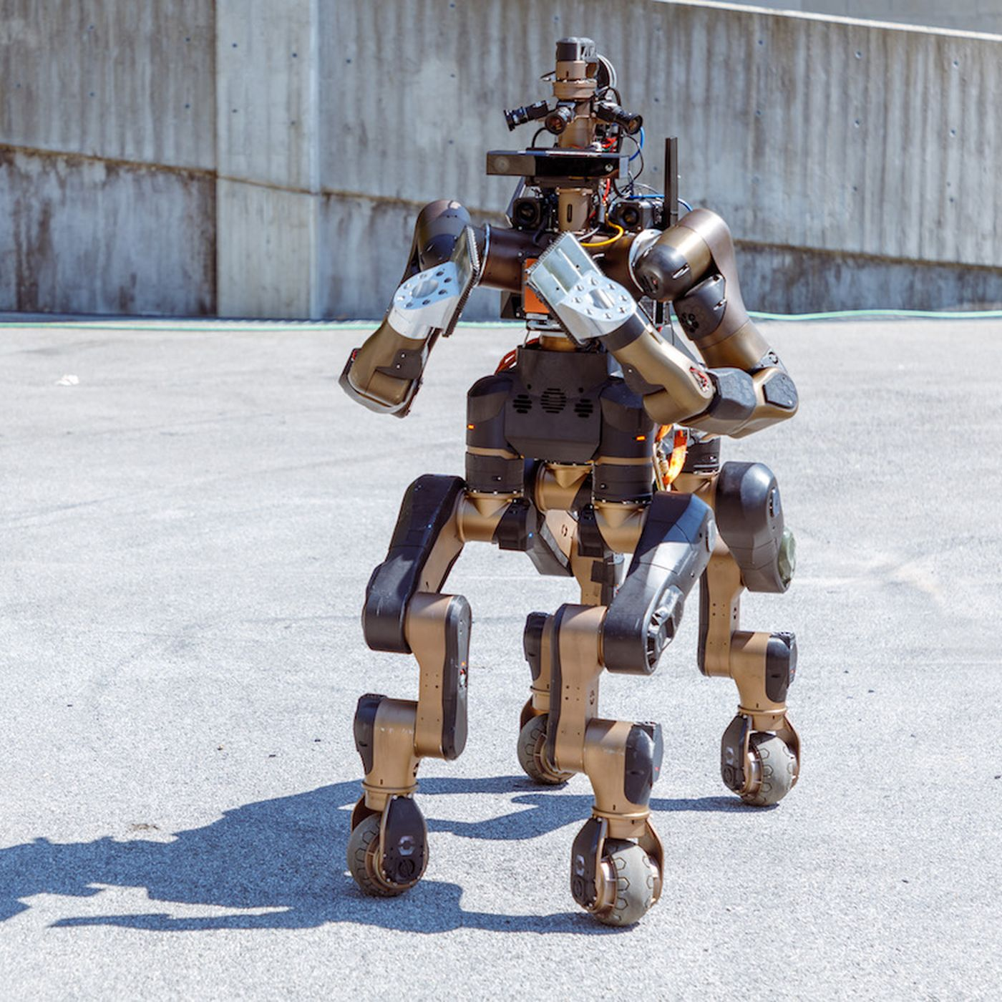
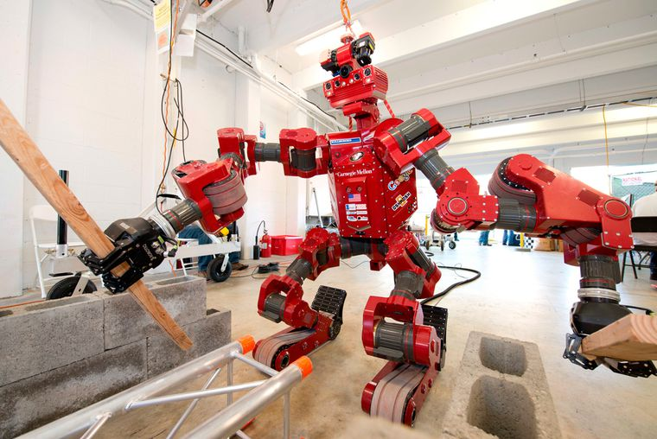
Motivation
In search and rescue missions, complex robots may compromise their performance in some tasks to accommodate a greater set of tasks.
A heterogeneous team of simple robots can maximize their strengths while complementing each other’s weaknesses.
These simple robots can achieve more working together than they could on their own but cost less than a single robot with the same combination of capabilities.

Slide 4
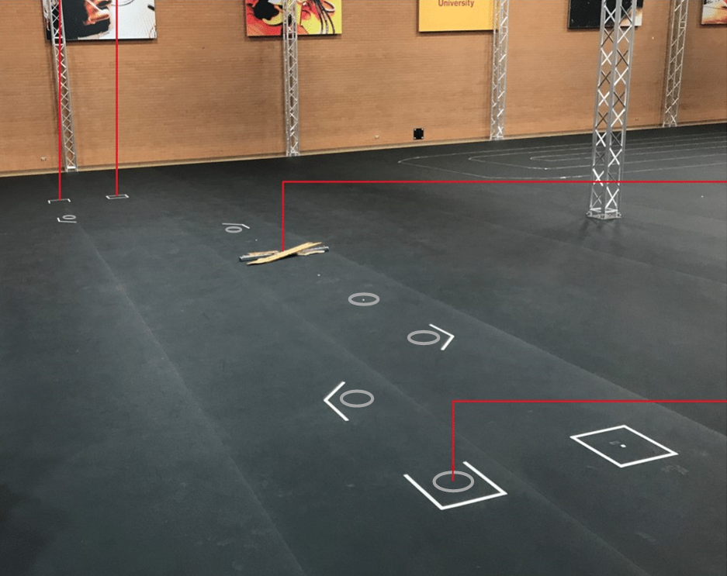
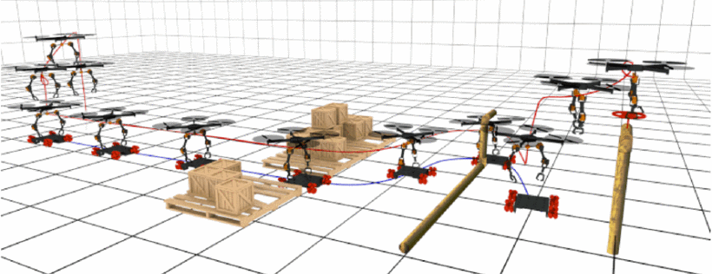
Problem Statement
Validate a symbiotic UAV and UGV relationship with a hardware experiment.
The team must be capable of the following:
The UGV must navigate a space while the UAV follows.
The UAV must couple with the UGV.
The UAV must lift the UGV over an obstacle.
The UGV must navigate the space while carrying the UAV.

Slide 5
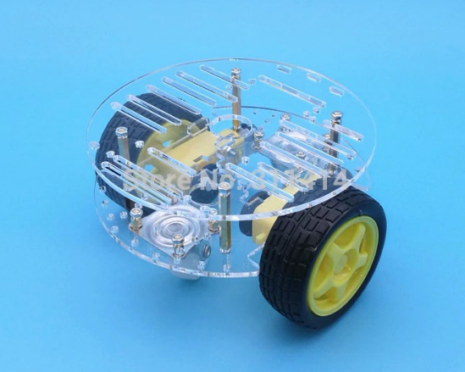
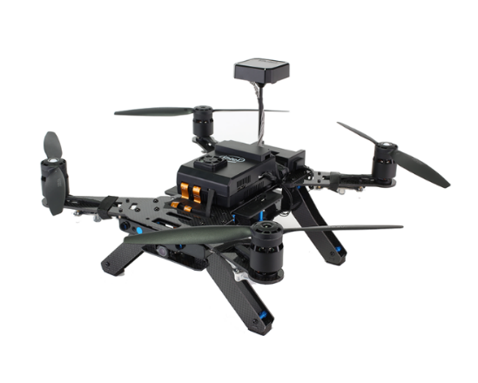
Robot Selection
UGV Requirements:
Mass < UAV payload capacity
Maneuverable in a hallway
Stable landing platform
UAV Requirements:
Payload > UGV mass
Maneuverable in a hallway
Two-Wheel Drive UGV:
Acrylic Chassis
140-millimeter diameter
330 grams
Four points of contact with the ground
Intel Aero Quadrotor UAV: small and powerful
Open frame
360-millimeter diagonal hub-to-hub length
1-kilogram payload
Figure 2: 2WD UGV Platform
Figure 3: Intel Aero UAV Platform
Notes:
The selection of robots primarily depends on the weight of the UGV and the payload capacity of the UAV.
UGV
Raspberry Pi
Motor HAT
Ubuntu MATE 16.04 operating system
ROS Kinetic
Adafruit_MotorHAT library
Laptop
Ubuntu 16.04 operating system
QGroundControl
UAV
Intel Aero Compute Board
Intel Aero Flight Controller
Ubuntu 16.04 operating system
ROS Kinetic
vrpn_client_ros package
mavros package
PX4 Autopilot
LPE position estimator

Slide 6
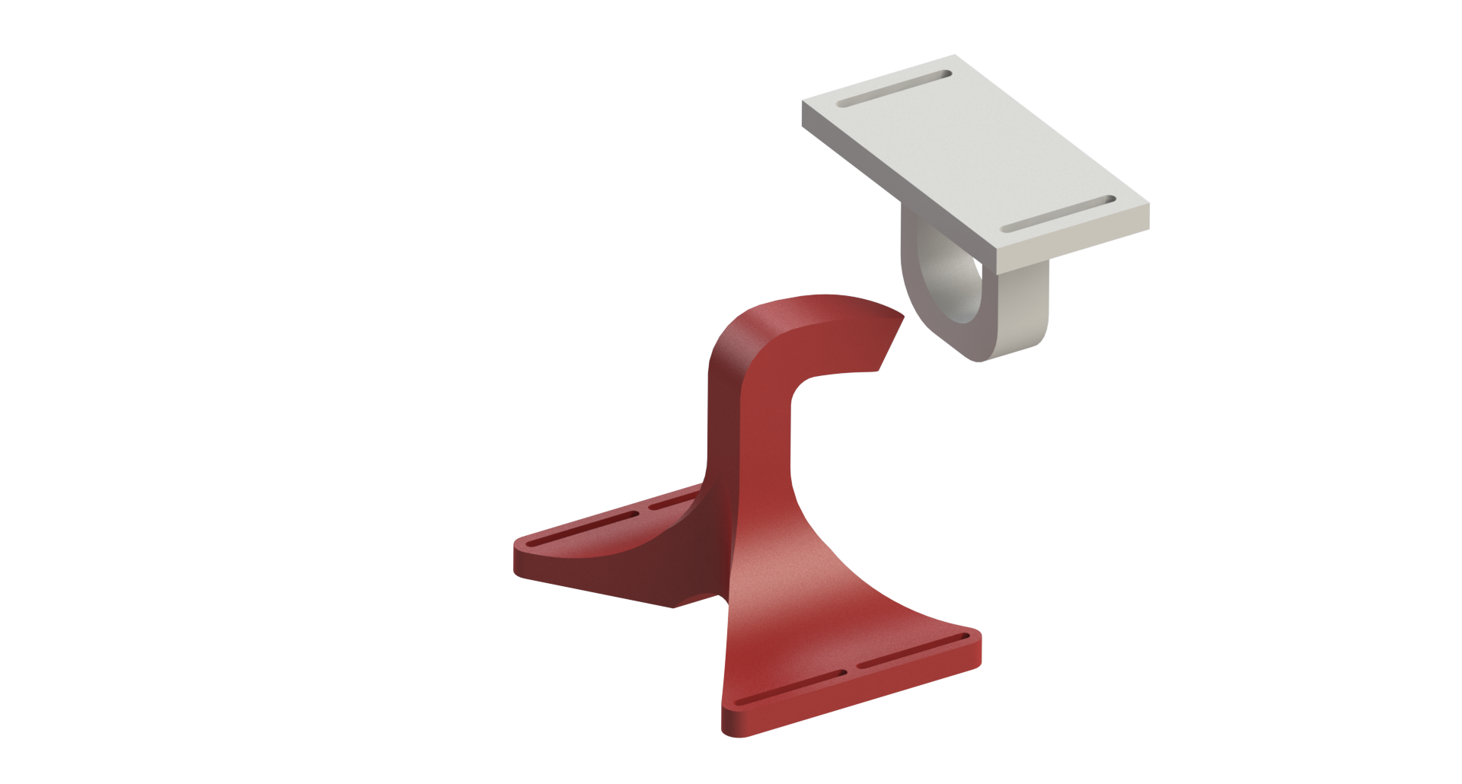
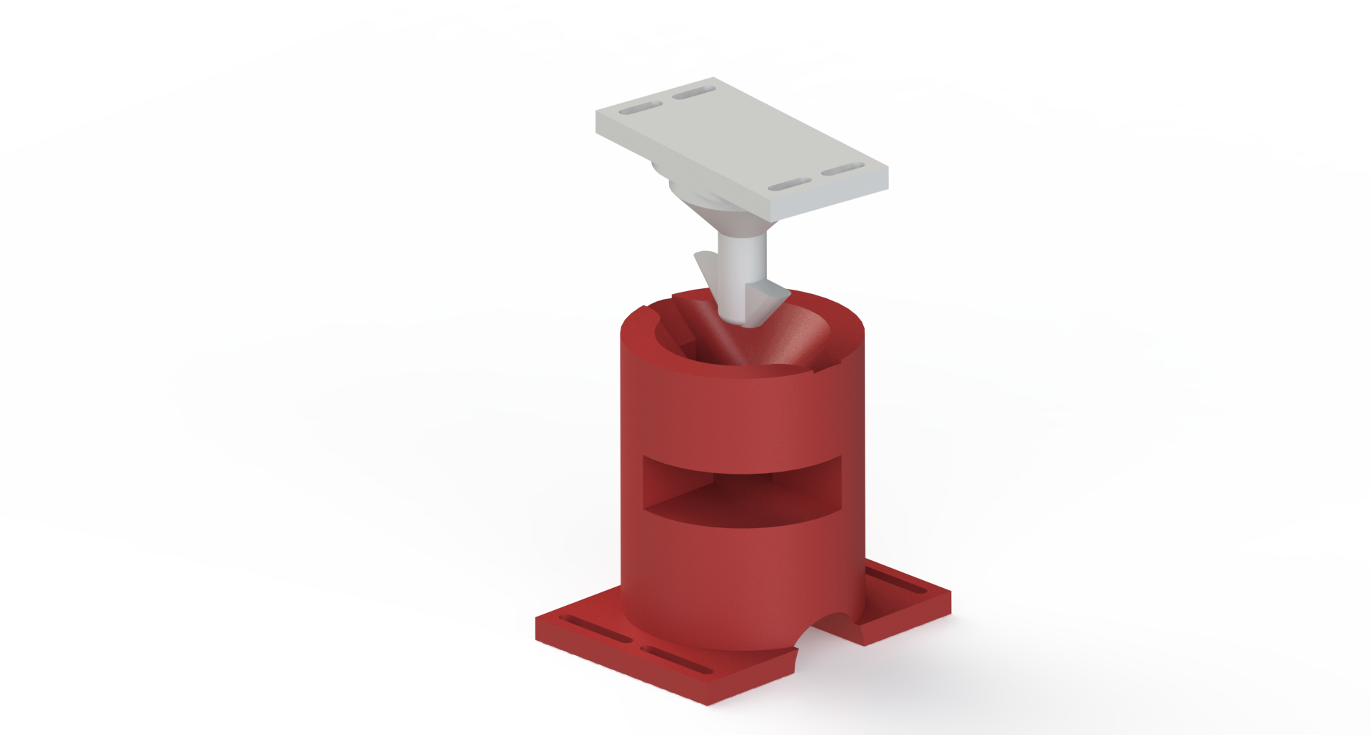
Coupling Mechanism Design Requirements
Primary Design Requirements:
The UAV must lift the UGV and remain coupled during flight.
The UGV must carry the UAV and remain coupled while driving.
Secondary Design Requirements:
The coupling mechanism must account for the robots’ resolution of control.
The coupling maneuver must be simple.
The coupling maneuver must preserve the orientation outputs of the robots
The coupling mechanism must not affect the flying and driving dynamics.
Not interfere with landing gear
Prevent crashing in case of coupling failure
Limit physical interactions before coupling

Slide 7
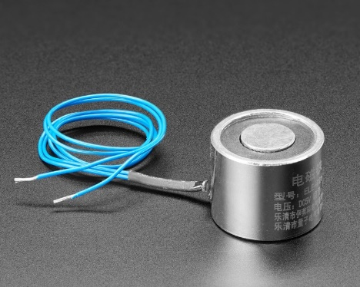
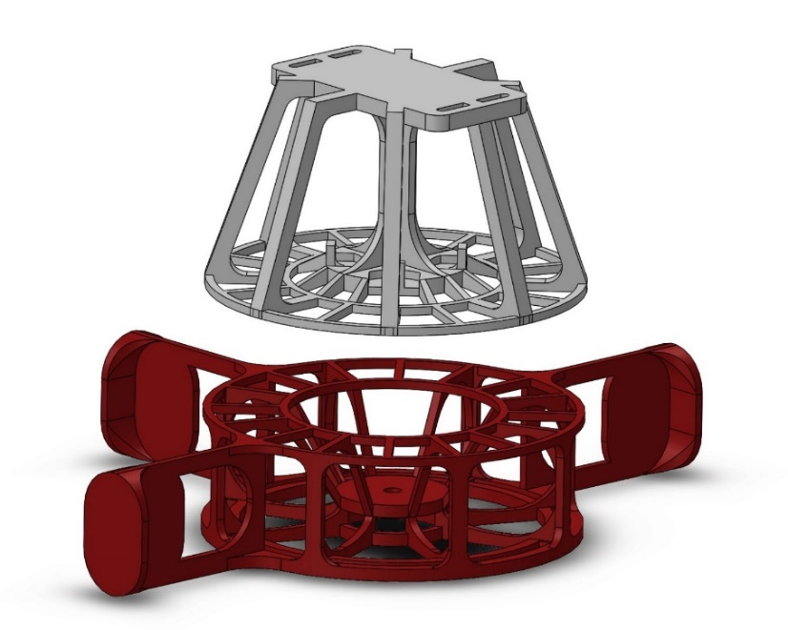
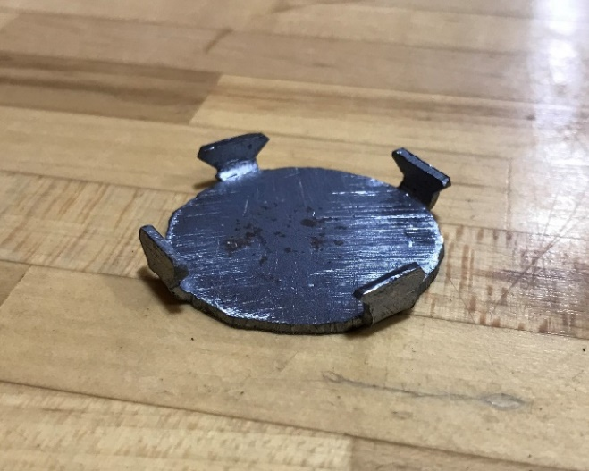
Method: Coupling Mechanism Design
UGV powers the connection during flight and when the UAV is out of battery.
90-millimeter circular ring prevents opening mode separation to stabilize the connection.
Slotted mounting point adjusts to the center of mass to preserve the dynamics of the system
Figure 4: EM Interface (Red) and FM Interface (White)
Notes:
Ferromagnet interface attaches a steel plate to the UAV.
Electromagnet interface attaches an electromagnet to the UGV.
The vertical descent preserves the other control outputs of the UAV.
Guiding forces account for control errors.
The process to engage and disengage the coupling mechanism occurs instantaneously.
Coupling Maneuver
UAV matches the UGV’s stationary ground position.
UGV engages the electromagnet.
UAV descends towards the UGV.
Electromagnetic forces guide the interfaces to the coupled position.
Decoupling Maneuver
UAV lands.
UGV disengages the electromagnet.
Electromagnet
5 kilogram holding force
0.3 amp draw at 5 volts
20 millimeters tall
25-millimeter diameter
Compatible with Raspberry Pi
Steel Plate
No residual pull
35-millimeter diameter

Slide 8
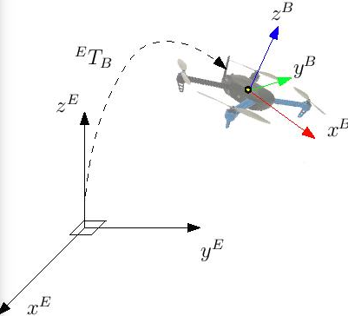
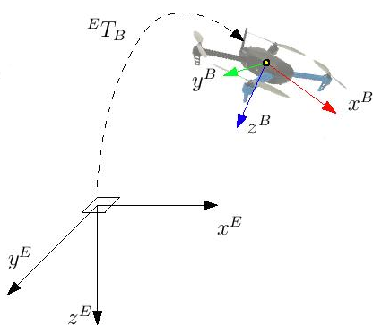
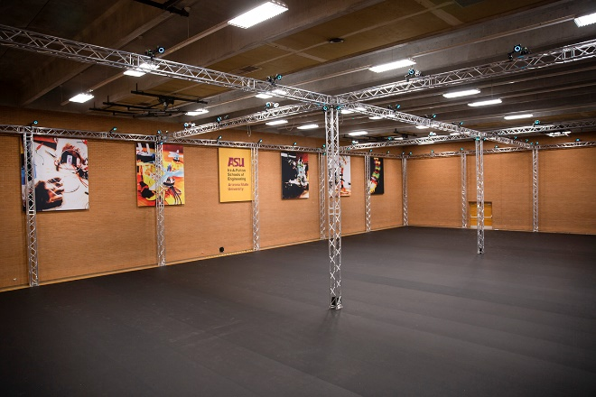
Method: Localization
This project was performed in ASU’s motion capture space.
This space tracks objects with an accuracy of < 1 millimeter in position and < 1° in orientation.
The desktop hosts a VRPN server that publishes the real-time pose data of the robots to the Wi-Fi network.
The UAV launches roscore and the vrpn_client_node which subscribes to the tracked objects published by the desktop.
The UGV communicates with the ROS master running on the UAV to receive the pose topics.
Figure 8: ROS frame: FLU/ENU
Figure 9: PX4 frame: FRD/NED
Figure 7: Motion Capture Space
Notes:
ROS Output:
Forward-Left-Up local frame
East-North-Up world frame
The UGV uses this frame of reference for its controls.
PX4 Input:
Forward-Right-Down local frame
North-East-Down world frame
The UAV uses this frame of reference for its controls.
VRPN client remaps the pose topic to /mavros/mocap/pose.
A mavros performs the transformation and relays it to the PX4.

Slide 9
Method: Offboard Position Control
WAYPOINTS, DIFFERENTIAL DRIVE
The UGV’s Python script subscribes to its pose topic and drives the vehicle through a list of predefined waypoints.
The UGV simulates a differential in the motors to steer itself to the waypoints.
A proportional-derivative controller calculates the steering differential required to drive the measured angle to the desired steering angle.
When the UGV reaches an acceptable distance to the waypoint, the UGV will target the next waypoint on its list or stop if it is at the end of its path.
The UGV engages the electromagnet with the same commands that drive the motors.
WAYPOINTS, MARGIN, DELAY
The UAV’s Python script subscribes to its pose topic and drives the vehicle through a list of predefined waypoints.
Offboard position control of the UAV is performed using the setpoint package in mavros.
The setpoint commands are accompanied by an acceptable distance and a delay.
The UAV flies within the acceptable distance to the waypoint and maintains that position for the duration of the delay.
After the delay, the UAV performs the next setpoint command.

Slide 10
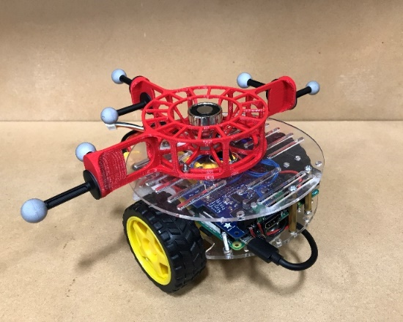
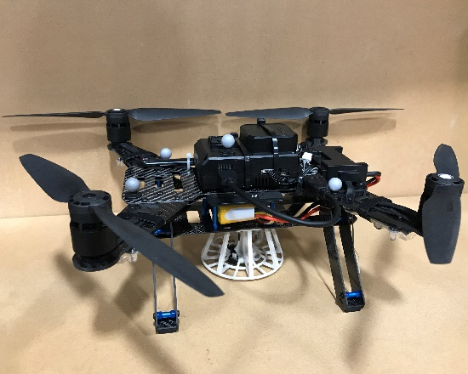
Method: Final Assembly
The EM interface was 3D printed.
The EM interface is mounted over the UGV’s center of mass.
Tracking markers are mounted to the wings.
The final assembly of the UGV weighs 639 grams.
The FM interface was 3D printed.
The FM interface is mounted below the UAV’s center of mass.
Tracking markers are mounted to the upper deck.
The final assembly of the UAV weighs 1015 grams.
The height of the mechanism is 8 centimeters.
The final assembly weighs 1654 grams.
246 grams below the maximum takeoff weight.
87% of the maximum takeoff weight.
159% increase in driving load.
63% increase in flying load.
UGV’s tracking markers extend beyond the landing gear of the UAV.
The landing gear of the UAV does not interfere with the coupling mechanism.
Figure 10: UGV Final Assembly
Figure 12: UAV Final Assembly
Figure 14: Coupled System Final Assembly

Slide 11
Experiment: Objective
Course is defined by six waypoints interrupted by an obstacle.
Uncoupled driving and flying through two 45-degree turns.
UAV performs coupling maneuver at the obstacle.
UAV lifts the UGV over the obstacle.
The team decouples briefly and couples again.
The UGV carries the UAV through two more 45-degree turns.
UGV Initial Position
UAV Initial Position
Obstacle
Coupled Final Position
Figure 15: Experimental Test Bed
Notes:
0Objective: Assess the capabilities of the robots according to the performance requirements described in the problem statement.
The UGV must navigate a space while the UAV follows.
The UAV must couple with the UGV.
The UAV must lift the UGV over an obstacle.
The UGV must navigate the space while carrying the UAV.
The motion capture space isolates the performance of the hardware.
The controlled environment limits disturbances to the system.
The tracking capabilities provide accurate localization.
The motion capture space can also store the tracking data for analysis.
After a series of simpler test beds, this is the final configuration.
Tethered test bed to test localization and control0

Slide 12
Experiment: Autonomous Controller Design
The UGV subscribes to: UGV pose, UAV pose, obstacle pose, fly mode
The UGV begins in “standby” mode and continually evaluates the distance to the UAV, to the waypoint, and to the obstacle.
When the UAV is within 10 centimeters of the UGV, the UGV switches to “drive” mode.
When the UGV is within 7 centimeters of a waypoint, it targets the next waypoint.
When the UGV is within 30 centimeters of the obstacle, it switches to “engage” mode.
During engage mode, the UGV receives instructions from the UAV via fly mode updates.
The UGV activates the electromagnet.
Notes:
The UAV subscribes to: UGV pose, UAV pose, obstacle pose
The UAV takes off and continually evaluates the UGV’s distance to the obstacle.
While the UGV drives, the UAV matches the UGV’s ground position with 10-centimeter accuracy.
When the UGV reaches the obstacle, the UAV saves the UGV’s stationary ground position and updates its fly mode to begin the coupling procedure.
The UAV targets waypoints over the coupling position with decreasing altitude and increasing accuracy until it reaches the coupling position.
The UAV targets a waypoint 0.6 meters above the coupling position with 20-centimeter accuracy to take off.
The UAV targets a waypoint on the far side of the obstacle, and one more waypoint in the landed position.
When the UAV lands, it waits 1 second to settle, updates the fly mode to decouple, waits 1 second for the electromagnet to disengage, then takes off again.
Once in the air, the UAV updates the fly mode, and continues following the UGV. At the third waypoint, the robots couple again.
Instead of lifting, the UAV updates the fly mode indicating a “resting” state and disarms its motors while the UGV carries it through the last two turns and stops at the final position.

Slide 13
(removed embedded video to reduce file size)
Video

Slide 14
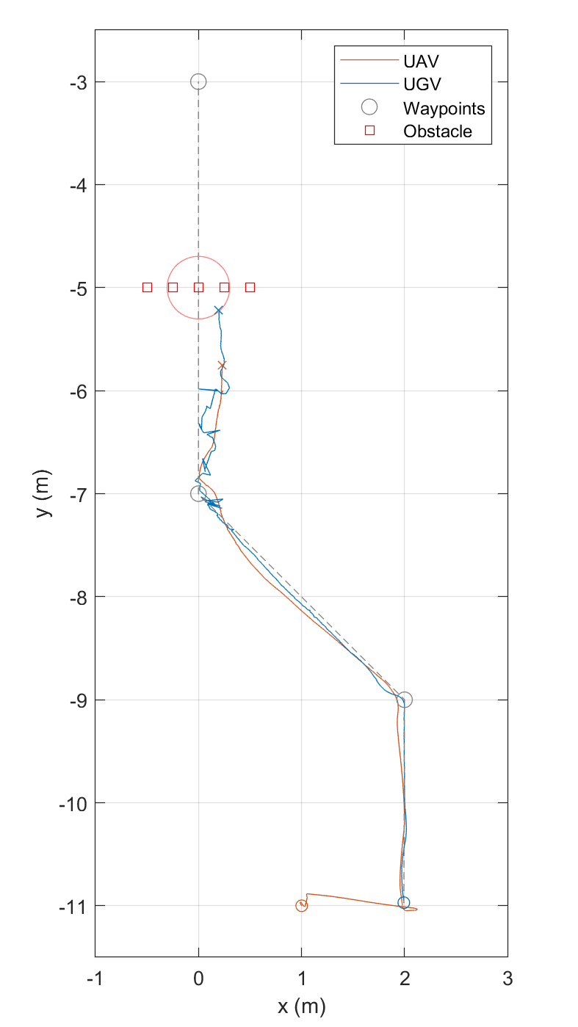
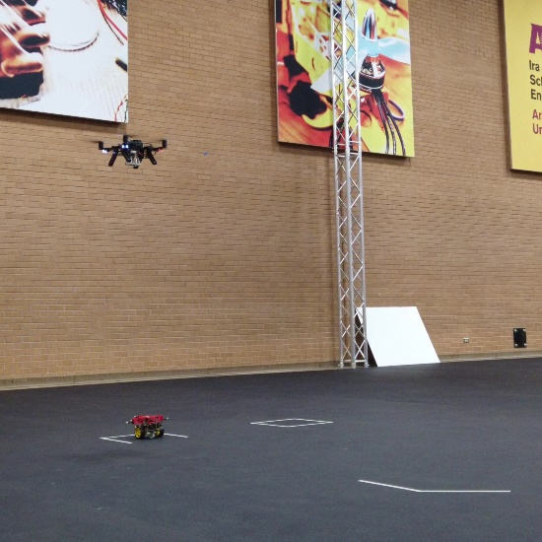
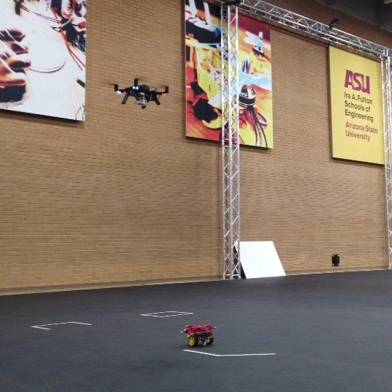
Results and Discussion: Following
Objective: Decoupled driving and flying through two 45-degree turns
Start: UAV takes off
End: UGV reaches the obstacle
Top view projected onto x-y plane
UGV targeted waypoints with minimal overshoot and settling time
UAV followed UGV through both 45-degree turns
UAV trailed ~1s and ~0.5 behind the UGV
Figure 17: Start Position
Figure 18: UAV Following UGV
Figure 16: Following Phase Tracking Map

Slide 15
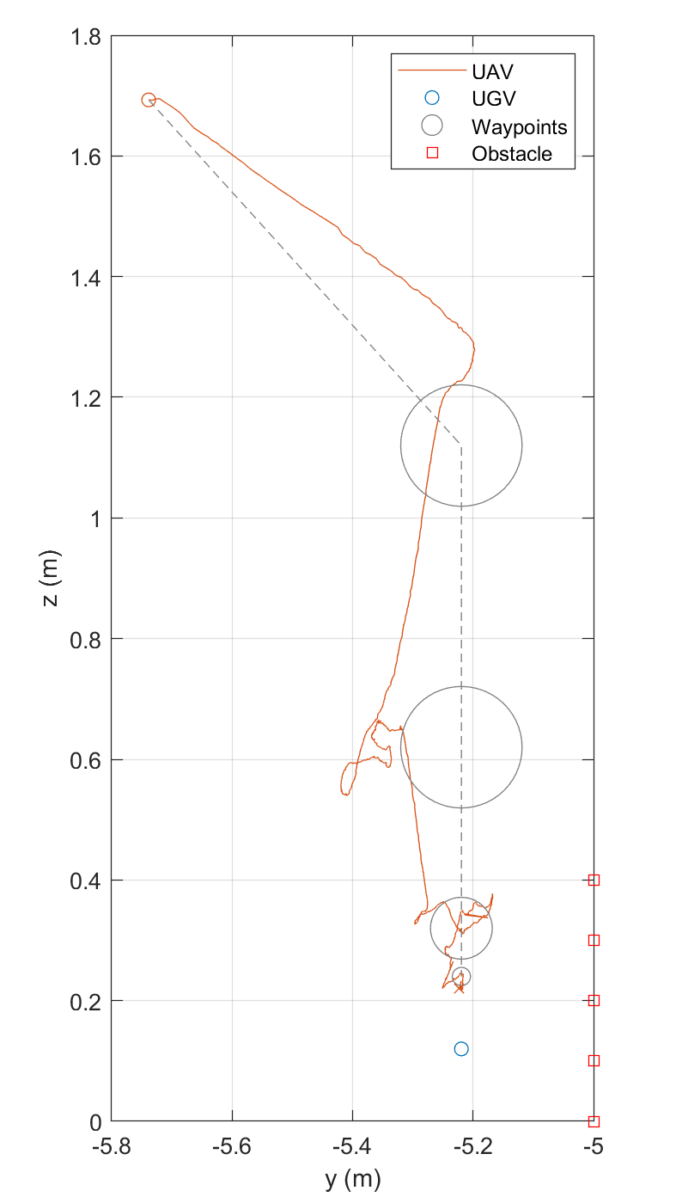
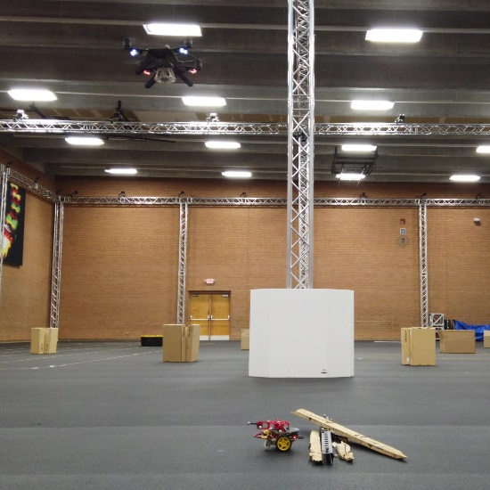
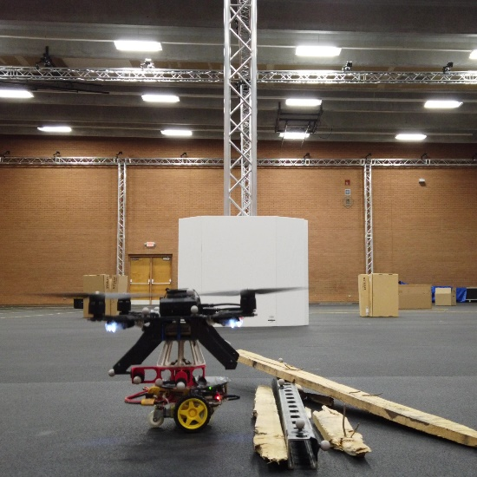
Results and Discussion: Coupling
Objective: UAV performs coupling maneuver with stationary UGV
Start: UGV reaches obstacle
End: Robots are coupled
Side view projected onto y-z plane
UAV targeted waypoints with minimal overshoot
Overshoot and error decreased as the accuracy increased
UAV met UGV at the coupling position
Figure 20: Initial Position
Figure 21: Coupled Position
Figure 19: Coupling Phase Tracking Map

Slide 16
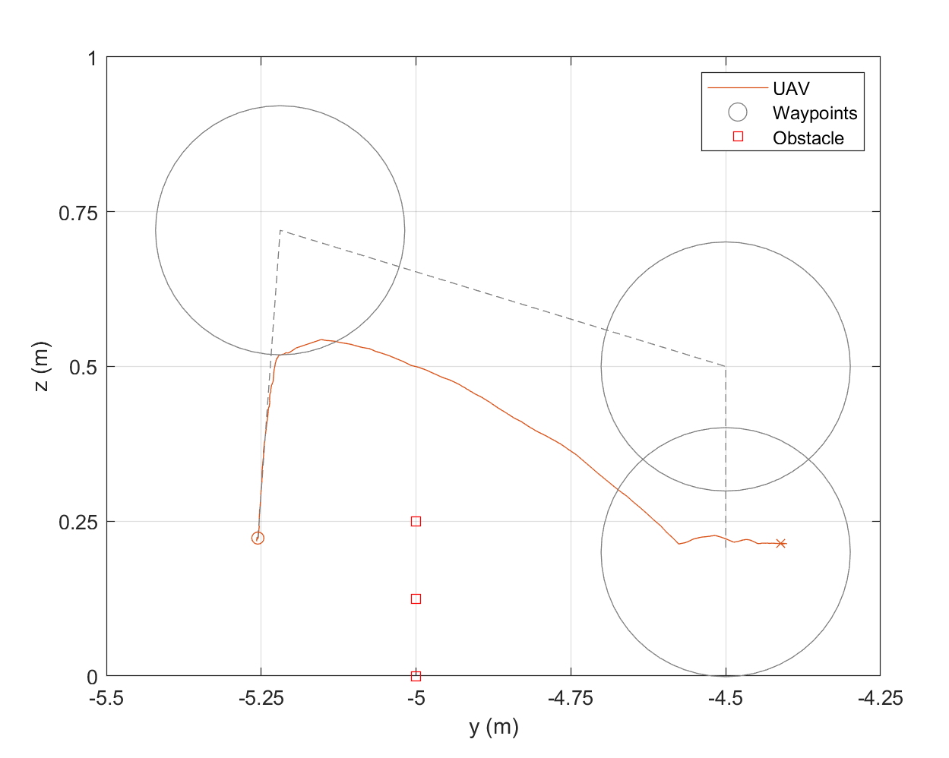
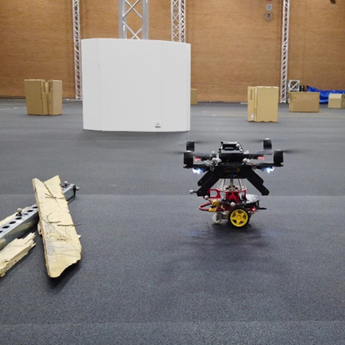
Results and Discussion: Lifting
Objective: UAV lifts UGV over obstacle
Start: UAV takes off
End: UAV lands
Side view projected onto y-z plane
UAV lifted UGV to first waypoint
UAV rolled too much and lost elevation
UAV still landed on the other side
Figure 23: UAV Lifting UGV
Figure 22: Lifting Phase Tracking Map
Figure 24: Landed Position

Slide 17
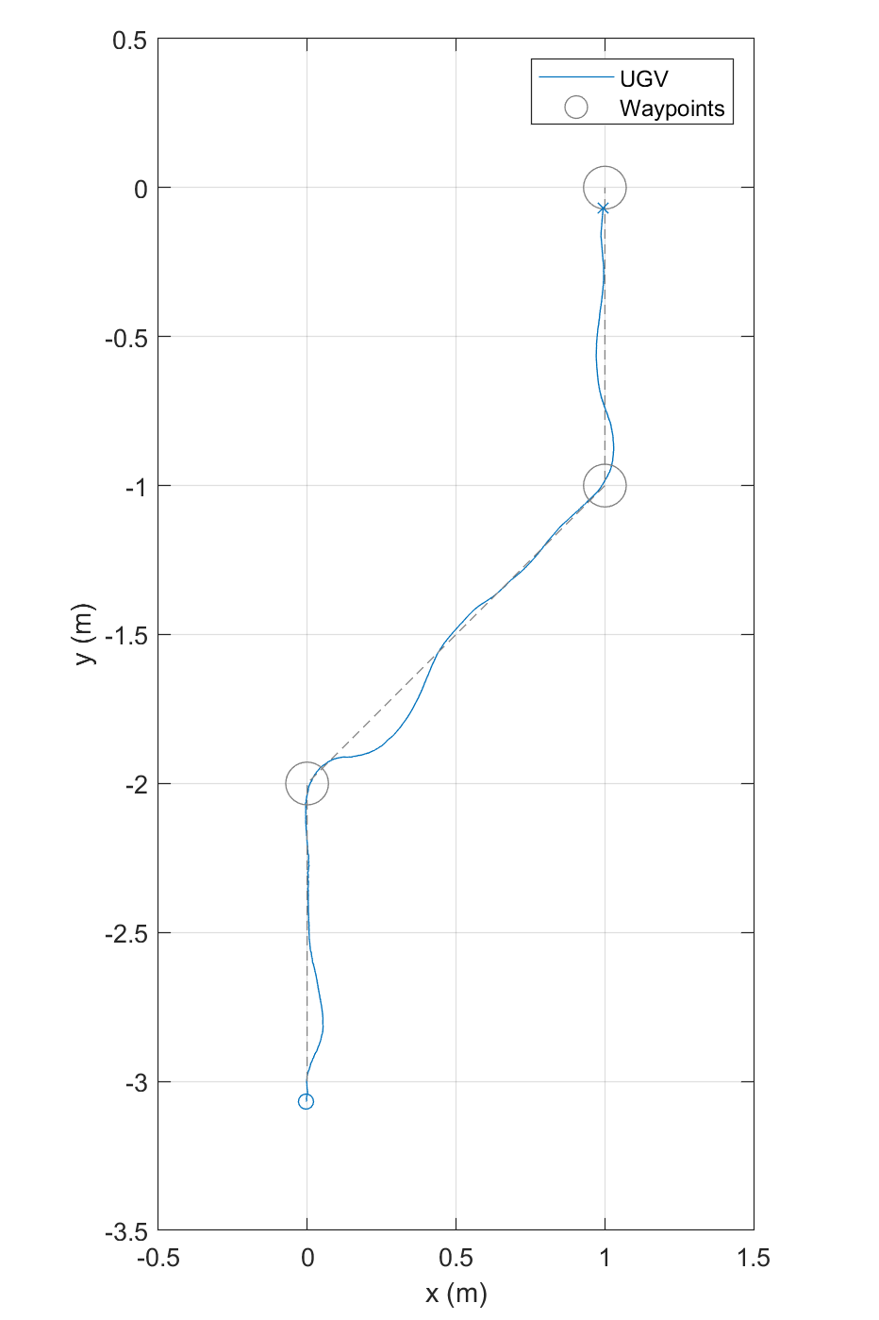
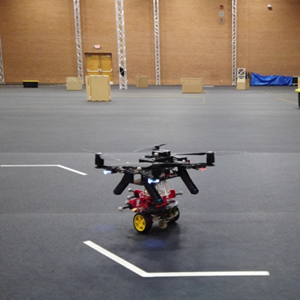
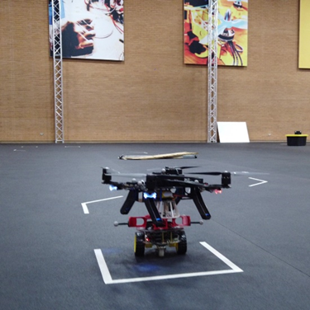
Results and Discussion: Resting
Objective: Coupled driving through two 45-degree turns
Start: UGV begins driving
End: UGV reaches final waypoint
Top view projected onto x-y plane
UGV targeted waypoints with greater overshoot and settling time than uncoupled driving
UGV drove at approximately the same speed
UGV carried UAV through both 45-degree turns
Figure 26: UGV Carrying UAV
Figure 25: Resting Phase Tracking Map
Figure 27: Final Position

Slide 18
Conclusion: Summary
The selection of robots meets the design requirements of the heterogenous team of robots.
The UGV is light and stable. The UAV is small and powerful.
The EM interface, the FM interface, and the coupling maneuver meet the design requirements of the coupling mechanism.
The coupling mechanism applies guiding forces, lifts the UGV, preserves the dynamics of the system, prevents opening mode separation, prevents interference with the rotors, prevents interference with the landing gear, prevents tracking interference, and causes no residual pull.
The coupling maneuver occurs in a single step and preserves the other control outputs of the UAV.
The process to engage and disengage the coupling mechanism occurs instantaneously.
Notes:
Improvements could be made to this system to address the diminished control of the robots under load.
The robots could adjust their controllers for loaded driving and flying.
The heterogenous team of robots could adapt to perform similar tasks.
UAV could lift the UGV up a flight of stairs.
This coupling mechanism could be modified to enable power sharing between the robots.
Sharing battery capacity and power can increase flight time and thrust.
The heterogeneous team of robots could be expanded to perform different tasks.
Distribute a suite of sensors, end effectors, and supplies across a larger team.
The concept of using a heterogenous team to perform complex tasks could be applied to other systems.
A heterogeneous team of nanorobots could perform more complex tasks.

Slide 19
Lessons learned
Lesson Learned:
Consider entire system / control when designing each part and how they affect each other
I learned how hard I can work while managing classes and work
Self taught everything

